Slide 1
Battle of Neighborhoods
Best location for a new Chinese restaurant

Slide 2
which neighborhood can win
The one which has large Chinese population
The one which has highest average income
The one which has not enough Chinese restaurants yet

Slide 3
Data acquisition and cleaning
Census data including Asian population, Chinese population, and average income is scraped from Toronto open data (https://open.toronto.ca/dataset/neighbourhood-profiles/)
Postcode and neighbourhood is scrapped from Wikipedia (https://en.wikipedia.org/wiki/List_of_postal_codes_of_Canada:_M)
Toronto geospatial data including the latitude and longitude of each neighbourhood (https://cocl.us/Geospatial_data)
Number of Chinese restaurant of each neighborhood (Foursquare API)

Slide 4
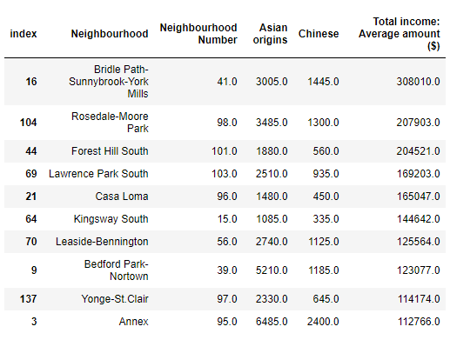
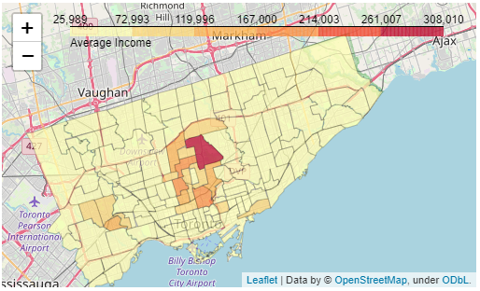
Average Income Distribution

Slide 5
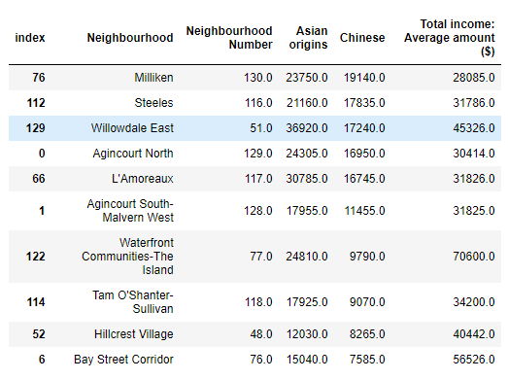
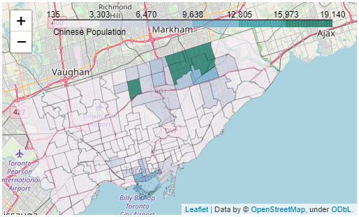
Chinese Population Districution

Slide 6
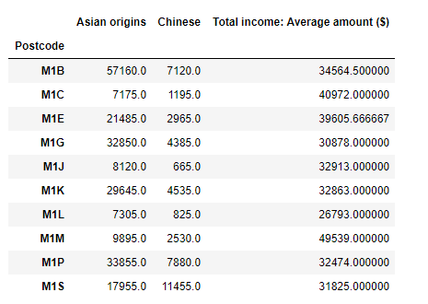
Merge census data by Postcode
Asian origins and Chinese Population is sum up for neighbourhoods with same postcode.
Total income is calculated mean value when merging several neighbourhoods.

Slide 7
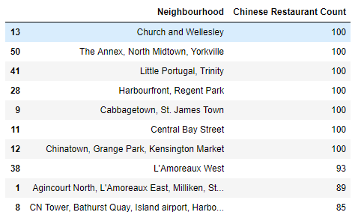
Use Foursquare API to find Chinese restaurants

Slide 8
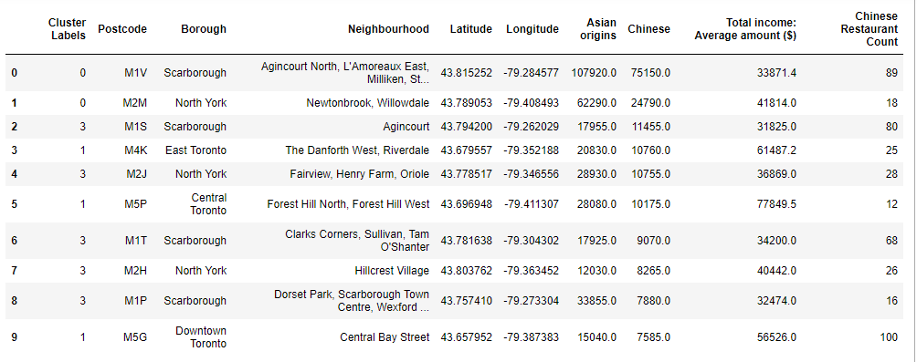
Combined all data together

Slide 9
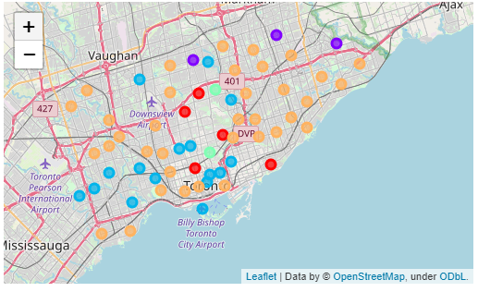
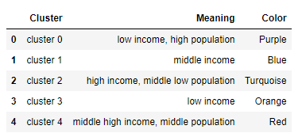
K-Mean Clustering to analyze neighbourhoods
K = 5
Limit = 500
Radius = 3000m
Query using Chinese restaurant categoryId

Slide 10
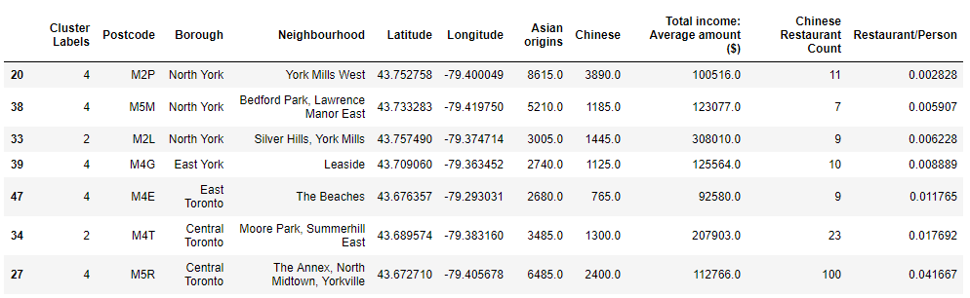
Calculate Chinese Restaurant Density
Investigate cluster 2 and cluster 4 for the reason of high income and relatively high Chinese population. Chinese restaurant density is calculated by Chinese restaurants counts/Chinese Population.

Slide 11
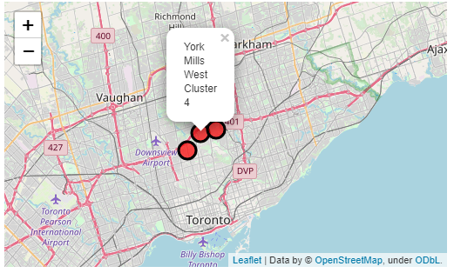
Conclusion
The next two neighbourhoods are "Bedford Park, Lawrence Manor East" and "Silver Hills, York Mills". The next two neighbourhoods are "Bedford Park, Lawrence Manor East" and "Silver Hills, York Mills".

